Slide 1
AP CS Creative Project
By: Sanjay Ganpat & Cori O’Donnell

Slide 2
A Brief Explanation (Theme)
Our project revolves around the internet and the impact which the internet has upon our students today. Based on Cori and I, the internet has impacted our lives by looking up and researching information based on prompts we have been given by teachers in class, such as Ap U.S History. We use the internet and incorporate our finding into work which we have to analyze and examine. The internet is a great resource toward our lives.

Slide 3
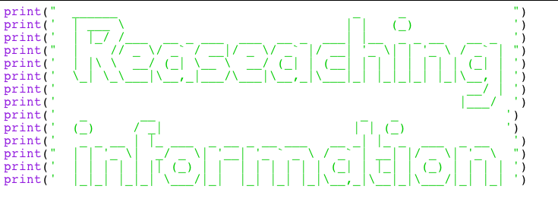

A coded, Visual Display

Slide 4

A Third Component
Another ASCII Art:

Slide 5
Diary Entry
Today we are looking to accomplish our project by finishing the song and adding it to power point and then adding our project to github

